Slide 1
Review Session 3
API-201, 9.24.21
Sophie Hill

Slide 2
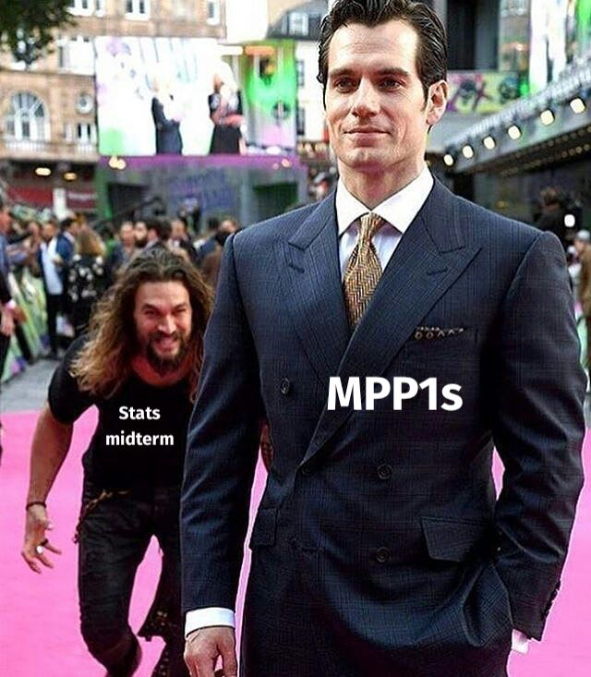

Slide 3
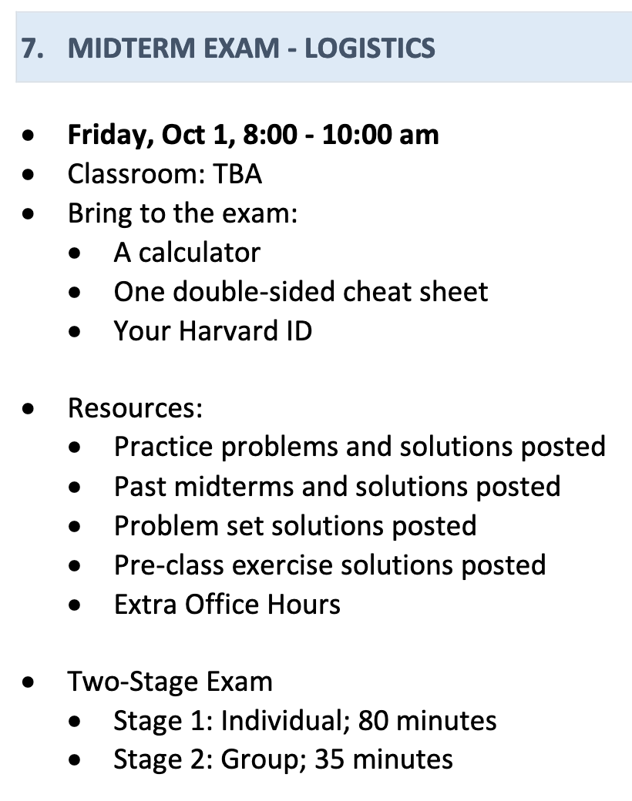

Slide 4
Cheat sheet
You can bring 1 double-sided cheat sheet into the midterm
<
Remember: the best cheat sheet is the one you make yourself
Focus on the topics you feel least comfortable with
You can include formulas… but also diagrams, tables, key takeaways, examples from class, and more!

Slide 5
Goals for today
Today we’re going to do a BUNCH of practice problems…
to review some recent material
to practice our exam strategies
and to build our confidence!

Slide 6
Practice Problem 1
Number of households by size
US Census data (2018)
Household Size (x) | n | P(X=x) | P(X ≤ x)
1 person | 35,740
2 people | 44,038
3 people | 19,333
4 people | 16,468
5 people | 7,442
6 people | 2,851
7+ people | 1,714
Total | 127,586
Use these raw numbers to fill out the table with the PMF (probability mass function) and CDF (cumulative distribution function).
Explain the meaning of the PMF and the CDF in this context, in terms that a non-statistician would understand. [2-3 sentences]

Slide 7

WAIT!
Before answering, search for clues.

Slide 8
Practice Problem 1
Number of households by size
US Census data (2018)
Aha! This question must be about probability distributions.
Household Size (x) | n | P(X=x) | P(X ≤ x)
1 person | 35,740
2 people | 44,038
3 people | 19,333
4 people | 16,468
5 people | 7,442
6 people | 2,851
7+ people | 1,714
Total | 127,586
Use these raw numbers to fill out the table with the PMF (probability mass function) and CDF (cumulative distribution function).
Explain the meaning of the PMF and the CDF in this context, in terms that a non-statistician would understand. [2-3 sentences]

Slide 9
Practice Problem 1
Number of households by size
US Census data (2018)
For part (a), all we have to do is fill out the table. Phew!
Household Size (x) | n | P(X=x) | P(X ≤ x)
1 person | 35,740
2 people | 44,038
3 people | 19,333
4 people | 16,468
5 people | 7,442
6 people | 2,851
7+ people | 1,714
Total | 127,586
Use these raw numbers to fill out the table with the PMF (probability mass function) and CDF (cumulative distribution function).
Explain the meaning of the PMF and the CDF in this context, in terms that a non-statistician would understand. [2-3 sentences]

Slide 10
Practice Problem 1
Number of households by size
US Census data (2018)
For part (b), we need to write 2-3 sentences.
Household Size (x) | n | P(X=x) | P(X ≤ x)
1 person | 35,740
2 people | 44,038
3 people | 19,333
4 people | 16,468
5 people | 7,442
6 people | 2,851
7+ people | 1,714
Total | 127,586
Use these raw numbers to fill out the table with the PMF (probability mass function) and CDF (cumulative distribution function).
Explain the meaning of the PMF and the CDF in this context, in terms that a non-statistician would understand. [2-3 sentences]

Slide 11
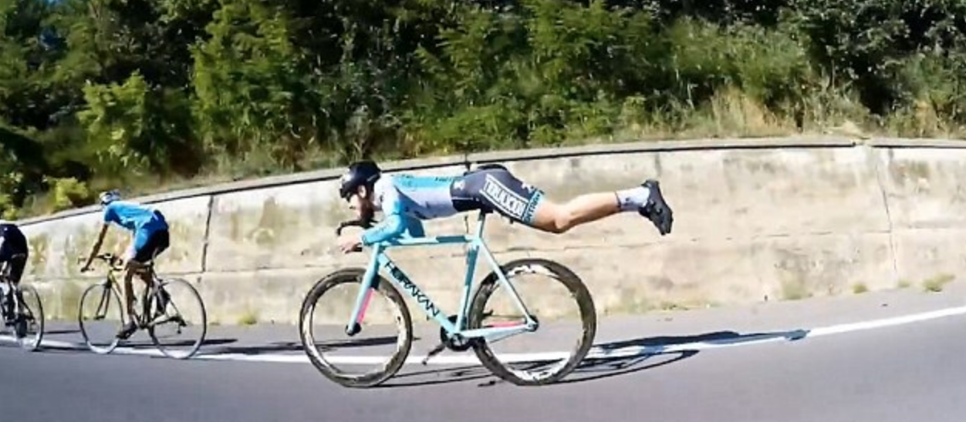
WORK SMARTER, NOT HARDER

Slide 12
Practice Problem 1
Number of households by size
US Census data (2018)
Household Size (x) | n | P(X=x) | P(X ≤ x)
1 person | 35,740
2 people | 44,038
3 people | 19,333
4 people | 16,468
5 people | 7,442
6 people | 2,851
7+ people | 1,714
Total | 127,586
Use these raw numbers to fill out the table with the PMF (probability mass function) and CDF (cumulative distribution function).
Explain the meaning of the PMF and the CDF in this context, in terms that a non-statistician would understand. [2-3 sentences]

Slide 13
Practice Problem 1
Number of households by size
US Census data (2018)
Household Size (x) | n | P(X=x) | P(X ≤ x)
1 person | 35,740 | 0.28
2 people | 44,038 | 0.35
3 people | 19,333 | 0.15
4 people | 16,468 | 0.13
5 people | 7,442 | 0.06
6 people | 2,851 | 0.02
7+ people | 1,714 | 0.01
Total | 127,586 | 1.00
Use these raw numbers to fill out the table with the PMF (probability mass function) and CDF (cumulative distribution function).
Explain the meaning of the PMF and the CDF in this context, in terms that a non-statistician would understand. [2-3 sentences]

Slide 14
Practice Problem 1
Number of households by size
US Census data (2018)
Household Size (x) | n | P(X=x) | P(X ≤ x)
1 person | 35,740 | 0.28 | 0.28
2 people | 44,038 | 0.35 | 0.63
3 people | 19,333 | 0.15 | 0.78
4 people | 16,468 | 0.13 | 0.91
5 people | 7,442 | 0.06 | 0.96
6 people | 2,851 | 0.02 | 0.99
7+ people | 1,714 | 0.01 | 1
Total | 127,586 | 1.00
Use these raw numbers to fill out the table with the PMF (probability mass function) and CDF (cumulative distribution function).
Explain the meaning of the PMF and the CDF in this context, in terms that a non-statistician would understand. [2-3 sentences]

Slide 15
Practice Problem 1
Number of households by size
US Census data (2018)
Explain the meaning of the PMF and the CDF in this context, in terms that a non-statistician would understand. [2-3 sentences]
Household Size (x) | n | P(X=x) | P(X ≤ x)
1 person | 35,740 | 0.28 | 0.28
2 people | 44,038 | 0.35 | 0.63
3 people | 19,333 | 0.15 | 0.78
4 people | 16,468 | 0.13 | 0.91
5 people | 7,442 | 0.06 | 0.96
6 people | 2,851 | 0.02 | 0.99
7+ people | 1,714 | 0.01 | 1
Total | 127,586 | 1.00

Slide 16
Practice Problem 1
Number of households by size
US Census data (2018)
Explain the meaning of the PMF and the CDF in this context, in terms that a non-statistician would understand. [2-3 sentences]
Household Size (x) | n | P(X=x) | P(X ≤ x)
1 person | 35,740 | 0.28 | 0.28
2 people | 44,038 | 0.35 | 0.63
3 people | 19,333 | 0.15 | 0.78
4 people | 16,468 | 0.13 | 0.91
5 people | 7,442 | 0.06 | 0.96
6 people | 2,851 | 0.02 | 0.99
7+ people | 1,714 | 0.01 | 1
Total | 127,586 | 1.00
The PMF tells us the probabilities of picking a household with size x: e.g., there is a 28% chance of picking a single-person household.
The CDF tells us the probability of picking a household with size x or less: e.g., there is a 96% chance of picking a household of up to 5 people.

Slide 17
Practice Problem 1
Number of households by size
US Census data (2018)
What is the probability of picking a household with 4 or more people at random from this sample?
Household Size (x) | n | P(X=x) | P(X ≤ x)
1 person | 35,740 | 0.28 | 0.28
2 people | 44,038 | 0.35 | 0.63
3 people | 19,333 | 0.15 | 0.78
4 people | 16,468 | 0.13 | 0.91
5 people | 7,442 | 0.06 | 0.96
6 people | 2,851 | 0.02 | 0.99
7+ people | 1,714 | 0.01 | 1
Total | 127,586 | 1.00

Slide 18
Practice Problem 1
Number of households by size
US Census data (2018)
What is the probability of picking a household with 4 or more people at random from this sample?
Household Size (x) | n | P(X=x) | P(X ≤ x)
1 person | 35,740 | 0.28 | 0.28
2 people | 44,038 | 0.35 | 0.63
3 people | 19,333 | 0.15 | 0.78
4 people | 16,468 | 0.13 | 0.91
5 people | 7,442 | 0.06 | 0.96
6 people | 2,851 | 0.02 | 0.99
7+ people | 1,714 | 0.01 | 1
Total | 127,586 | 1.00
Using the PDF:
P(4 ppl or more)
= P(4 ppl) + P(5 ppl)
+ P(6 ppl) + P(7 ppl or more)
= 0.13 + 0.06 + 0.02 + 0.01
= 0.22

Slide 19
Practice Problem 1
Number of households by size
US Census data (2018)
What is the probability of picking a household with 4 or more people at random from this sample?
Household Size (x) | n | P(X=x) | P(X ≤ x)
1 person | 35,740 | 0.28 | 0.28
2 people | 44,038 | 0.35 | 0.63
3 people | 19,333 | 0.15 | 0.78
4 people | 16,468 | 0.13 | 0.91
5 people | 7,442 | 0.06 | 0.96
6 people | 2,851 | 0.02 | 0.99
7+ people | 1,714 | 0.01 | 1
Total | 127,586 | 1.00
Using the CDF:
P(4 ppl or more)
= 1 - P(3 ppl or less)
= 1 - 0.78
= 0.22

Slide 20
Practice Problem 1
Number of households by size
US Census data (2018)
What is the probability of picking a household with 4 or more people at random from this sample?
Household Size (x) | n | P(X=x) | P(X ≤ x)
1 person | 35,740 | 0.28 | 0.28
2 people | 44,038 | 0.35 | 0.63
3 people | 19,333 | 0.15 | 0.78
4 people | 16,468 | 0.13 | 0.91
5 people | 7,442 | 0.06 | 0.96
6 people | 2,851 | 0.02 | 0.99
7+ people | 1,714 | 0.01 | 1
Total | 127,586 | 1.00
If you just wrote the number 0.22, you might get full credit. But if you made a typo or an error in your calculation, you’d get none!
By laying out what I’m doing (using the PDF/CDF) and writing out the equation in notation before plugging in the numbers, I am ensuring that I can get some credit even if the final answer is wrong.
Using the CDF:
P(4 ppl or more)
= 1 - P(3 ppl or less)
= 1 - 0.78
= 0.22

Slide 21
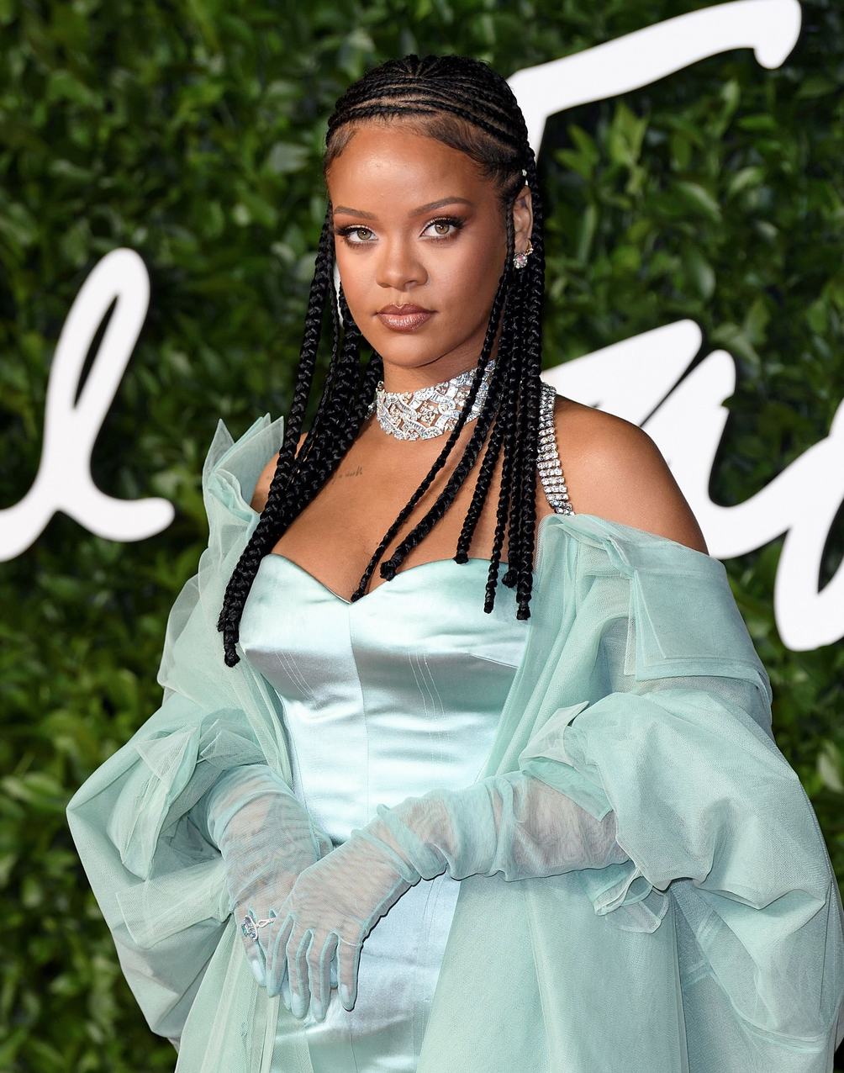
You gotta show your work (work work work work)

Slide 22
Practice Problem 2
Your friend at a different school just got back their midterm results. They got 83/100 on the stats midterm and 94/100 on the econ midterm.
Your friend tells you: “I scored 11 points higher on the econ midterm than the stats midterm. I never knew I was so much better at econ than at stats!” Do you agree with their conclusion? [1-2 sentences]

Slide 23
Practice Problem 2
This question is about comparing distributions. But note that part (a) only requires 1-2 sentences.
Your friend at a different school just got back their midterm results. They got 83/100 on the stats midterm and 94/100 on the econ midterm.
Your friend tells you: “I scored 11 points higher on the econ midterm than the stats midterm. I never knew I was so much better at econ than at stats!” Do you agree with their conclusion? [1-2 sentences]

Slide 24
Practice Problem 2
Your friend at a different school just got back their midterm results. They got 83/100 on the stats midterm and 94/100 on the econ midterm.
Your friend tells you: “I scored 11 points higher on the econ midterm than the stats midterm. I never knew I was so much better at econ than at stats!” Do you agree with their conclusion? [1-2 sentences]
No. In order to compare our friend’s performance on both midterms, we would want to know how they performed relative to others in the class. To do this, we would need some more information about the distribution of both sets of test scores.

Slide 25
Practice Problem 2
Your friend at a different school just got back their midterm results. They got 83/100 on the stats midterm and 94/100 on the econ midterm.
Your friend takes your advice and asks the professors for more information. The stats professor says their scores were normally distributed with a mean of 77 and a standard deviation of 3. The econ professors says their scores were normally distributed with a mean of 88 and a standard deviation of 6.
“Aha!,” says your friend, “I scored 6 points above the class average on both tests. That means I am equally good at stats and econ!” Do you agree with this conclusion? [1 paragraph]

Slide 26
Practice Problem 2
We are given some explicit numbers here so we should expect to do some calculations. “1 paragraph” means we need to explain and interpret these calculations.
Your friend at a different school just got back their midterm results. They got 83/100 on the stats midterm and 94/100 on the econ midterm.
Your friend takes your advice and asks the professors for more information. The stats professor says their scores were normally distributed with a mean of 77 and a standard deviation of 3. The econ professors says their scores were normally distributed with a mean of 88 and a standard deviation of 6.
“Aha!,” says your friend, “I scored 6 points above the class average on both tests. That means I am equally good at stats and econ!” Do you agree with this conclusion? [1 paragraph]

Slide 27
Practice Problem 2
Stats ~ N(77, 3), our friend scored 83
Econ ~ N(88, 6), our friend scored 94

Slide 28
Practice Problem 2
Stats ~ N(77, 3), our friend scored 83
Econ ~ N(88, 6), our friend scored 94
Our friend is correct that they scored 6 points above the class average on both midterms. However, in order to interpret this, we need to take into account the spread of the test scores, which is captured by the standard deviation. We can do this by calculating the Z-scores:
Z = (student’s score - mean) / (standard deviation)
Z_{stats} = (83 - 77)/3 = 6/3 = 2 Z_{econ} = (94 - 88)/6 = 6/6 = 1
Our friend scored 2 standard deviations above the mean on stats, but only 1 standard deviation above the mean on econ. So our friend actually did better (relative to the class) on stats than on econ!

Slide 29
Practice Problem 2
Summarizing information from the question
Stats ~ N(77, 3), our friend scored 83
Econ ~ N(88, 6), our friend scored 94
Our friend is correct that they scored 6 points above the class average on both midterms. However, in order to interpret this, we need to take into account the spread of the test scores, which is captured by the standard deviation. We can do this by calculating the Z-scores:
Z = (student’s score - mean) / (standard deviation)
Z_{stats} = (83 - 77)/3 = 6/3 = 2 Z_{econ} = (94 - 88)/6 = 6/6 = 1
Our friend scored 2 standard deviations above the mean on stats, but only 1 standard deviation above the mean on econ. So our friend actually did better (relative to the class) on stats than on econ!

Slide 30
Practice Problem 2
Showing conceptual understanding
Stats ~ N(77, 3), our friend scored 83
Econ ~ N(88, 6), our friend scored 94
Our friend is correct that they scored 6 points above the class average on both midterms. However, in order to interpret this, we need to take into account the spread of the test scores, which is captured by the standard deviation. We can do this by calculating the Z-scores:
Z = (student’s score - mean) / (standard deviation)
Z_{stats} = (83 - 77)/3 = 6/3 = 2 Z_{econ} = (94 - 88)/6 = 6/6 = 1
Our friend scored 2 standard deviations above the mean on stats, but only 1 standard deviation above the mean on econ. So our friend actually did better (relative to the class) on stats than on econ!

Slide 31
Practice Problem 2
Knowing the correct formula to use
Stats ~ N(77, 3), our friend scored 83
Econ ~ N(88, 6), our friend scored 94
Our friend is correct that they scored 6 points above the class average on both midterms. However, in order to interpret this, we need to take into account the spread of the test scores, which is captured by the standard deviation. We can do this by calculating the Z-scores:
Z = (student’s score - mean) / (standard deviation)
Z_{stats} = (83 - 77)/3 = 6/3 = 2 Z_{econ} = (94 - 88)/6 = 6/6 = 1
Our friend scored 2 standard deviations above the mean on stats, but only 1 standard deviation above the mean on econ. So our friend actually did better (relative to the class) on stats than on econ!

Slide 32
Practice Problem 2
Applying the formula
Stats ~ N(77, 3), our friend scored 83
Econ ~ N(88, 6), our friend scored 94
Our friend is correct that they scored 6 points above the class average on both midterms. However, in order to interpret this, we need to take into account the spread of the test scores, which is captured by the standard deviation. We can do this by calculating the Z-scores:
Z = (student’s score - mean) / (standard deviation)
Z_{stats} = (83 - 77)/3 = 6/3 = 2 Z_{econ} = (94 - 88)/6 = 6/6 = 1
Our friend scored 2 standard deviations above the mean on stats, but only 1 standard deviation above the mean on econ. So our friend actually did better (relative to the class) on stats than on econ!

Slide 33
Practice Problem 2
Interpreting the results
Stats ~ N(77, 3), our friend scored 83
Econ ~ N(88, 6), our friend scored 94
Our friend is correct that they scored 6 points above the class average on both midterms. However, in order to interpret this, we need to take into account the spread of the test scores, which is captured by the standard deviation. We can do this by calculating the Z-scores:
Z = (student’s score - mean) / (standard deviation)
Z_{stats} = (83 - 77)/3 = 6/3 = 2 Z_{econ} = (94 - 88)/6 = 6/6 = 1
Our friend scored 2 standard deviations above the mean on stats, but only 1 standard deviation above the mean on econ. So our friend actually did better (relative to the class) on stats than on econ!

Slide 34
Practice Problem 3
The Harvard Graduate Student Union (HGSU) is currently bargaining with the administration over a new contract for TFs, CAs, and RAs. The union wants to achieve the biggest pay rise for its 2,000 members, and it has two options: continue to negotiate with the administration or call a strike.
If the union continues the negotiations, there is 20% chance of a deadlock (no pay raise), and a 80% chance of securing a $1 hourly raise. (That equates to an aggregate gain of $1/hr * 20hrs/wk * 24 wks * 2,000 members = $960,000.)
If the union calls a strike, it incurs a cost of $640,000 of strike pay for workers whose wages are withheld. In this case, there is a 50% chance of a deadlock and a 50% of a $3 hourly raise.
Assuming that the union is risk neutral, what should it do?

Slide 35
Practice Problem 3
Looks like this is a question on risk analysis!
The Harvard Graduate Student Union (HGSU) is currently bargaining with the administration over a new contract for TFs, CAs, and RAs. The union wants to achieve the biggest pay rise for its 2,000 members, and it has two options: continue to negotiate with the administration or call a strike.
If the union continues the negotiations, there is 20% chance of a deadlock (no pay raise), and a 80% chance of securing a $1 hourly raise. (That equates to an aggregate gain of $1/hr * 20hrs/wk * 24 wks * 2,000 members = $960,000.)
If the union calls a strike, it incurs a cost of $640,000 of strike pay for workers whose wages are withheld. In this case, there is a 50% chance of a deadlock and a 50% of a $3 hourly raise.
Assuming that the union is risk neutral, what should it do?

Slide 36
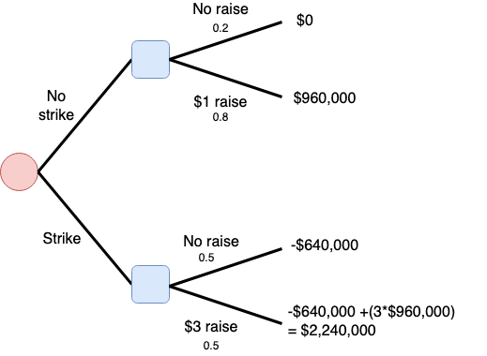
Practice Problem 3
EV_{no strike}
= 0.2*$0 + 0.8*$960,000
= $768,000
EV_{strike}
= 0.5*(-$640,000) + 0.5(-$640,000 + 3*$960,000)
= $800,000

Slide 37
Practice Problem 3
EV_{no strike} = $768,000
EV_{strike} = $800,000
The question tells us that the union is risk neutral. Therefore, the union should choose to call a strike, since option provides a higher expected value.

Slide 38
Practice Problem 3
Jk
Suppose the union is uncertain about the total cost of strike pay (since it is not clear ex ante how many workers will have their wages withheld).
What is the cost of strike pay that would make the union indifferent between the two options?

Slide 39
Practice Problem 3
The union is indifferent when:
EV_{no strike} = EV_{strike}
In this sensitivity analysis, we are going to let the cost of strike pay vary, but everything else is fixed. So EV_{no strike} is still $768,000.
$768,000 = 0.5*(-x) + 0.5(-x + 3*$960,000)
$768,000 = -x + 0.5*3*$960,000
$768,000 = -x + $1,440,000
x = $1,440,000 - $768,000
= $672,000
Jk
Suppose the union is uncertain about the total cost of strike pay (since it is not clear ex ante how many workers will have their wages withheld).
What is the cost of strike pay that would make the union indifferent between the two options?

Slide 40
Practice Problem 4
A relative of yours just texted you the following:
“I heard on the news that 75 out of the 100 people in the ICU with COVID had been vaccinated!! I TOLD you, those “vaccines” actually make you more likely to get serious COVID! It’s such a shame that only 600 people in our town of 20,000 are still unvaccinated.” Do you agree with their conclusions?
P(unvax) = 600/20,000 = 0.03 P(vax) = 1 - 0.03 = 0.97
P(ICU) = 100/20,000 = 0.005 P(not in ICU) = 1 - 0.005 = 0.995
P(vax | ICU) = 0.75 P(unvax | ICU) = 1 - 0.75 = 0.25

Slide 41
Practice Problem 4
A relative of yours just texted you the following:
“I heard on the news that 75 out of the 100 people in the ICU with COVID had been vaccinated!! I TOLD you, those “vaccines” actually make you more likely to get serious COVID! It’s such a shame that only 600 people in our town of 20,000 are still unvaccinated.” Do you agree with their conclusions?
P(unvax) = 600/20,000 = 0.03 P(vax) = 1 - 0.03 = 0.97
P(ICU) = 100/20,000 = 0.005 P(not in ICU) = 1 - 0.005 = 0.995
P(vax | ICU) = 0.75 P(unvax | ICU) = 1 - 0.75 = 0.25

Slide 42
Practice Problem 4
P(unvax) = 0.03 P(vax) = 0.97
P(ICU) = 0.005 P(not in ICU) = 0.995
P(vax | ICU) = 0.75 P(unvax | ICU) = 0.25
Our relative has got their conditional probabilities mixed up. They are pointing to the fact that P(vax | ICU) > P(unvax | ICU).
But in order to determine whether the vaccinated or unvaccinated have a higher chance of ending up in the ICU with Covid, we actually need to compare P(ICU | vax) and P(ICU | unvax).

Slide 43
Practice Problem 4
The multiplication rule tells us that P(A|B) = P(A&B)/P(B).
So we can rewrite these conditional probabilities as follows:
P(ICU | vax) = P(ICU & vax) / P(vax)
P(ICU | unvax) = P(ICU & unvax) / P(unvax)

Slide 44
Practice Problem 4
We can use the multiplication rule again - this time to rewrite the joint probability!
P(ICU | vax) = P(ICU & vax) / P(vax)
= [P(vax | ICU)*P(ICU)] / P(vax)
P(ICU | unvax) = P(ICU & unvax) / P(unvax)
= [P(unvax | ICU)*P(ICU)] / P(unvax)

Slide 45
Practice Problem 4
P(unvax) = 0.03 P(vax) = 0.97
P(ICU) = 0.005 P(not in ICU) = 0.995
P(vax | ICU) = 0.75 P(unvax | ICU) = 0.25
P(ICU | vax) = P(ICU & vax) / P(vax)
= [P(vax | ICU)*P(ICU)] / P(vax) = (0.75*0.005)/0.97 = 0.004
P(ICU | unvax) = P(ICU & unvax) / P(unvax)
= [P(unvax | ICU)*P(ICU)] / P(unvax) = (0.25*0.005) / 0.03 = 0.04

Slide 46
Practice Problem 4
The probability of being in the ICU given that you are vaccinated is 0.4%.
The probability of being in the ICU given that you are unvaccinated is 4%.
So, we do not agree with our relative’s conclusions. Based on these numbers, the risk of serious Covid is actually 10 times higher for the unvaccinated compared to the vaccinated.

Slide 47
Practice Problem 4
Jk
One of your friends, who is also taking API-201, says that your relative’s confusion stems from the Base Rate Fallacy. Explain what the Base Rate Fallacy is and how it might apply in this particular context. [1 paragraph]

Slide 48
Practice Problem 4
Jk
One of your friends, who is also taking API-201, says that your relative’s confusion stems from the Base Rate Fallacy. Explain what the Base Rate Fallacy is and how it might apply in this particular context. [1 paragraph]
The Base Rate Fallacy occurs when we draw conclusions about a characteristic based on new information, without taking the prevalence of that characteristic into account.
In this case, our relative failed to take the prevalence of vaccination into account when interpreting the fact that 75% of those in the ICU were vaccinated. Consider an extreme case, where 100% of the town is vaccinated, and there is just 1 person in the ICU. Then 100% of the ICU patients are vaccinated, but the risk of serious COVID with vaccination is very small!

Slide 49

Great job everyone!!

